Slide 1

User Testing
HME

Slide 2
Browsing + Search

Slide 3
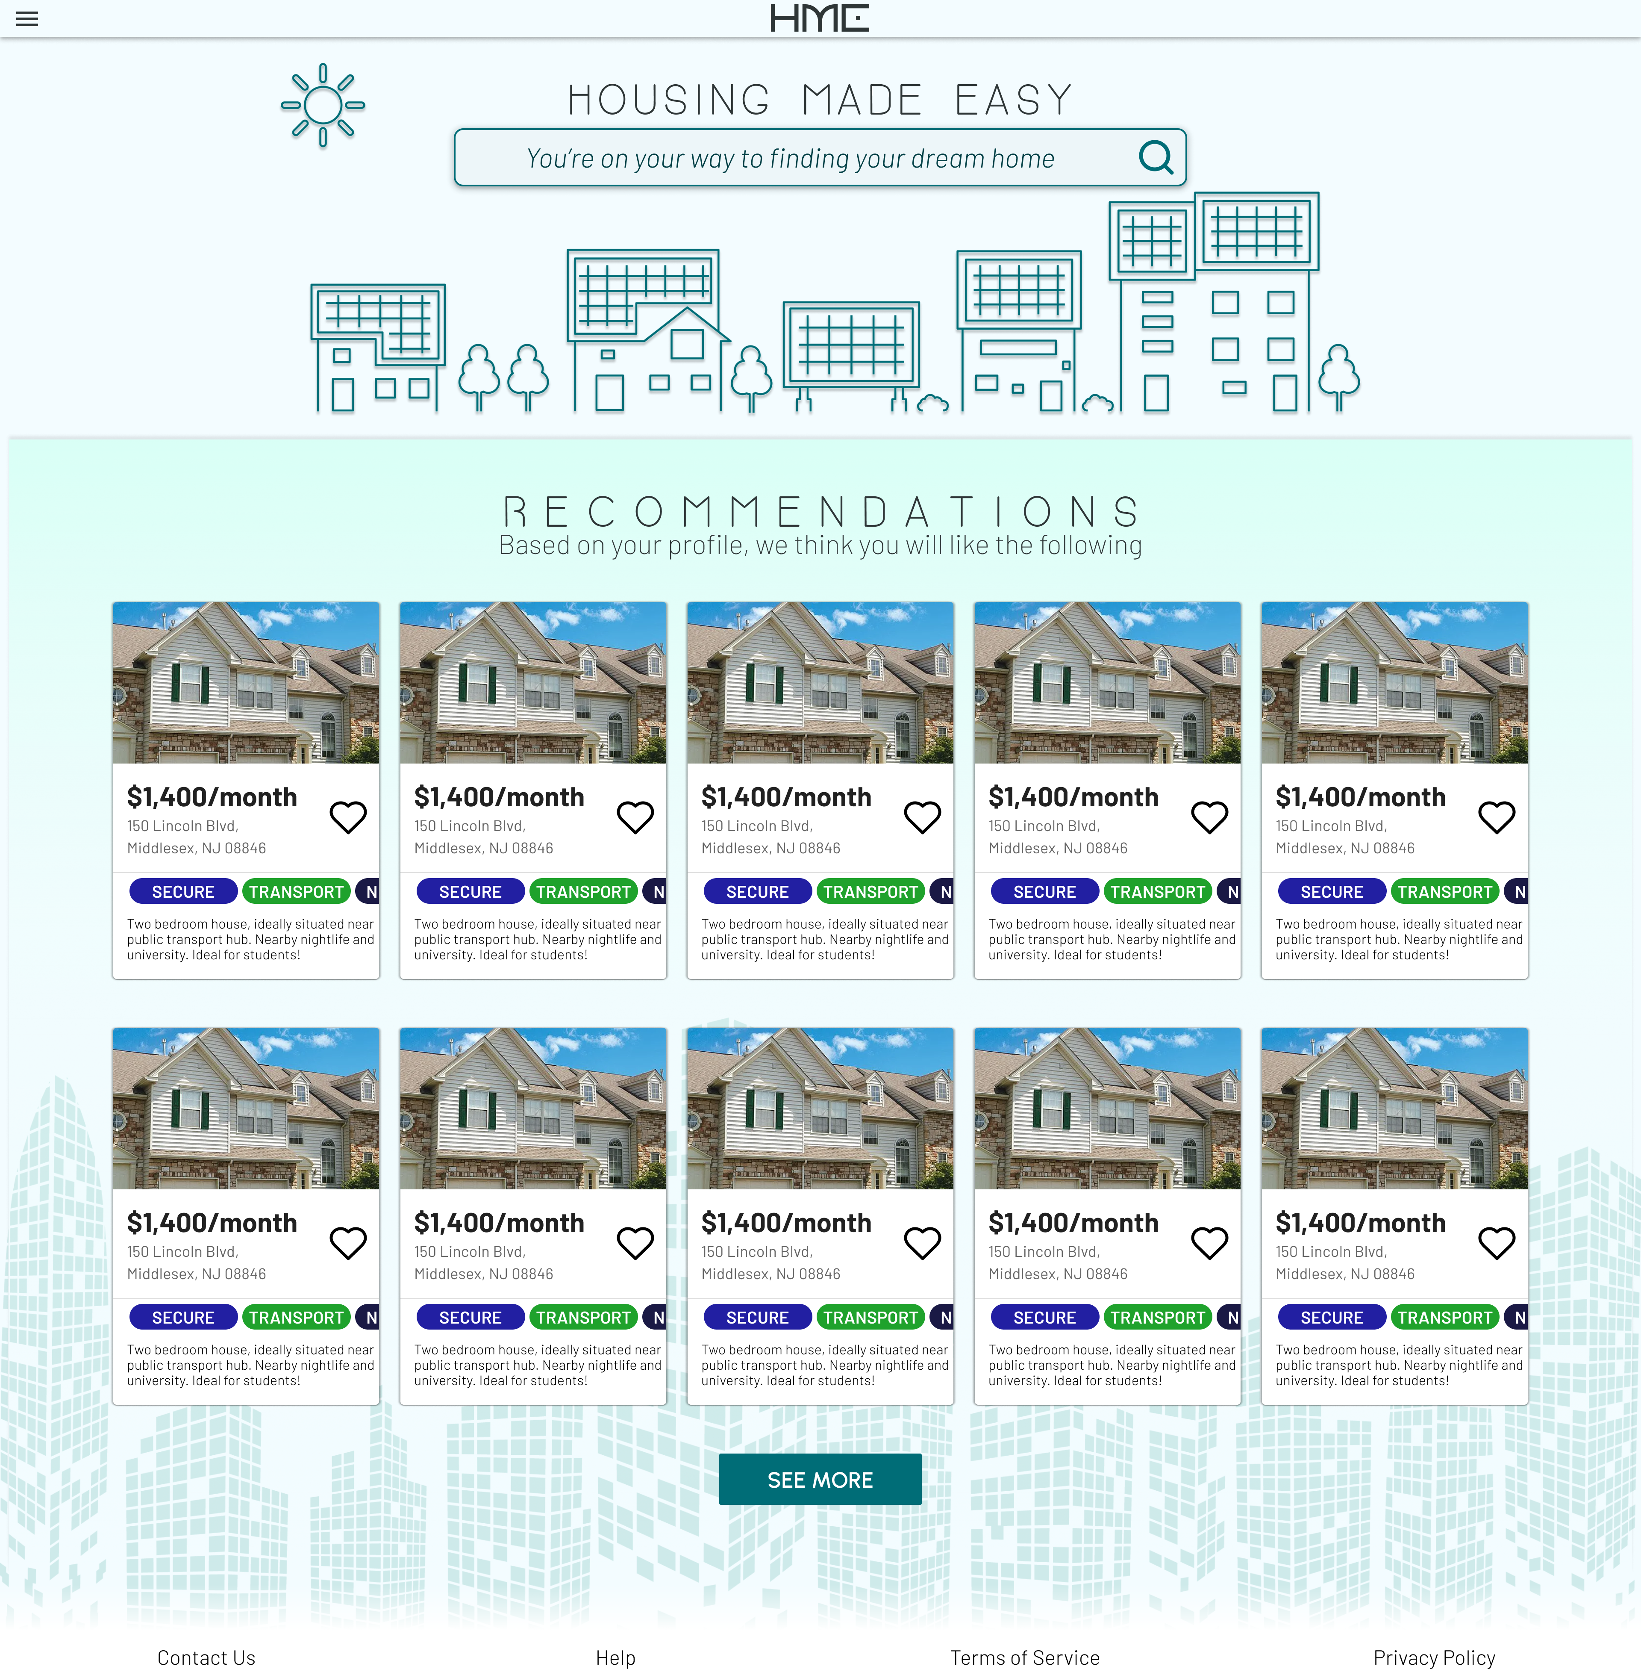

Slide 4


Slide 5
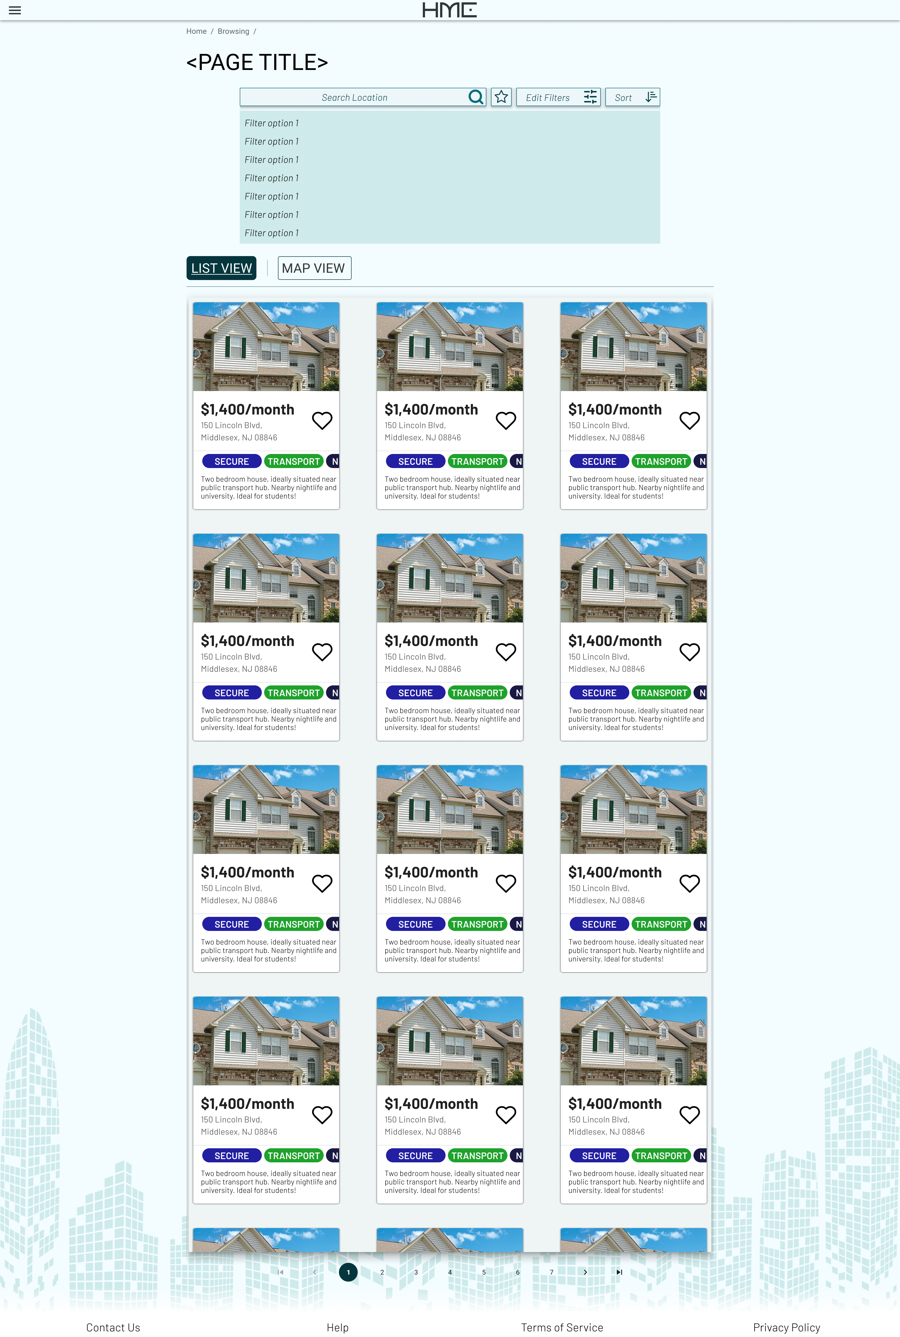

Slide 6


Slide 7
Favoriting

Slide 9
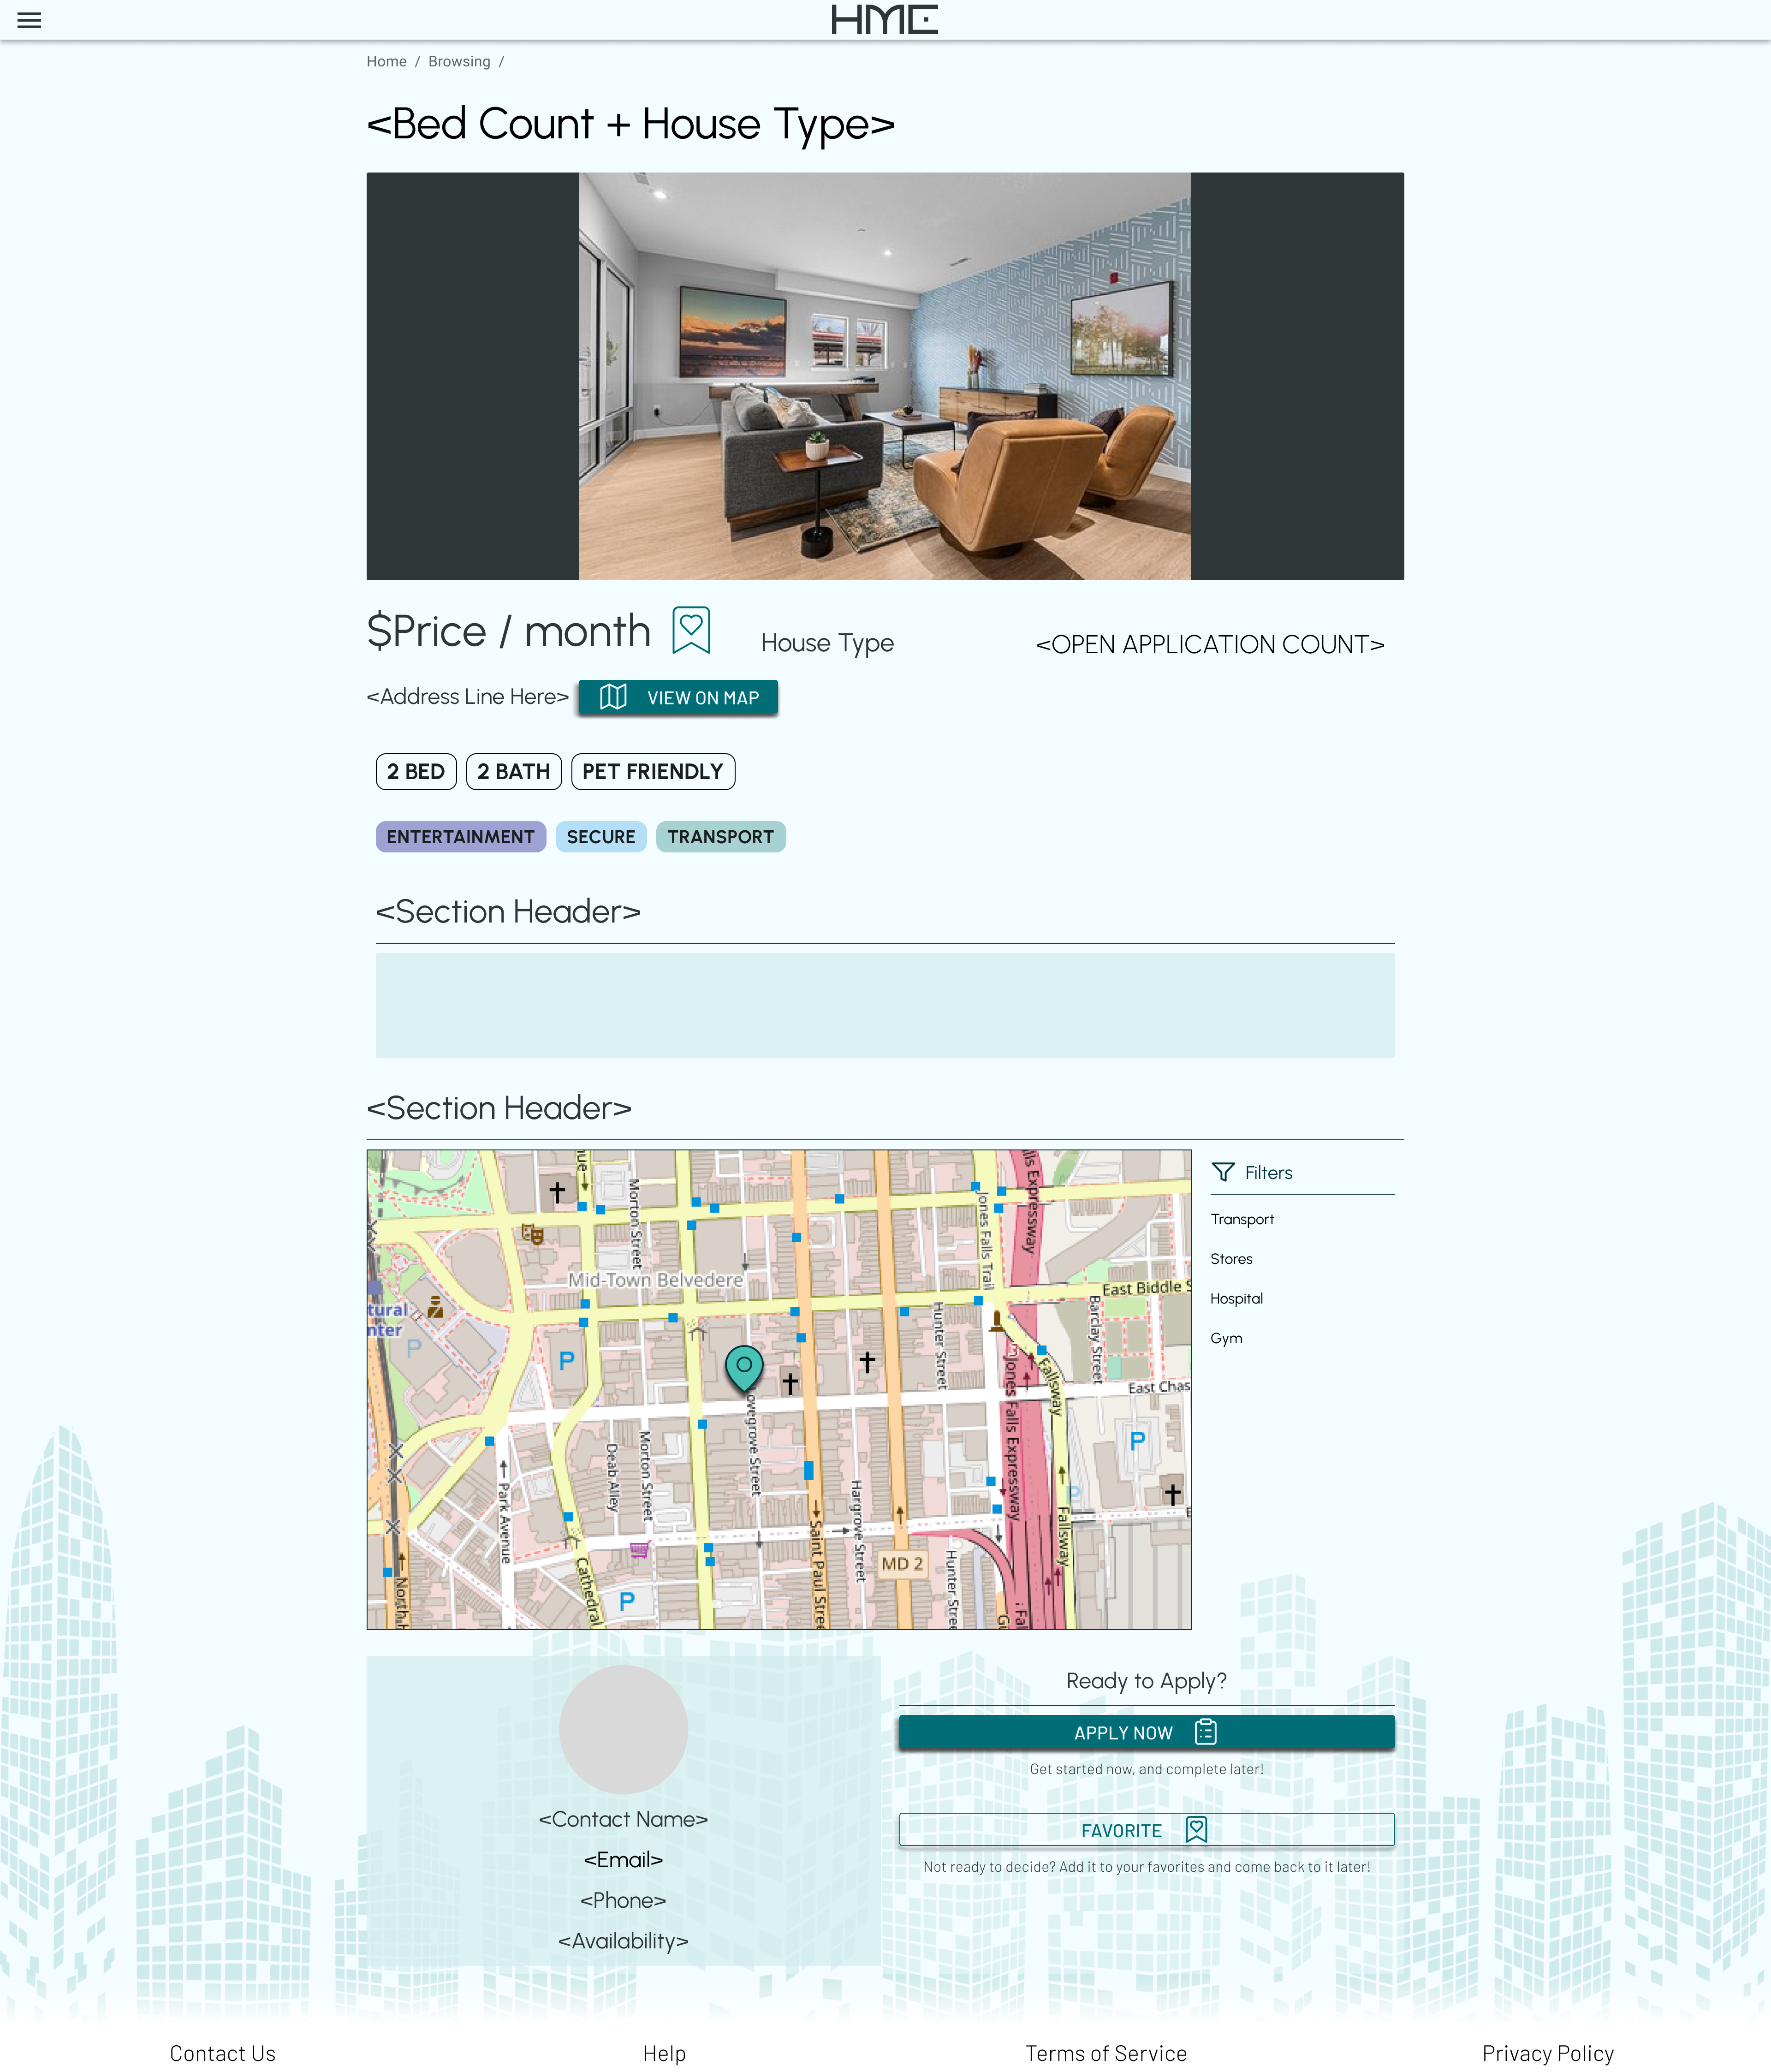

Slide 10
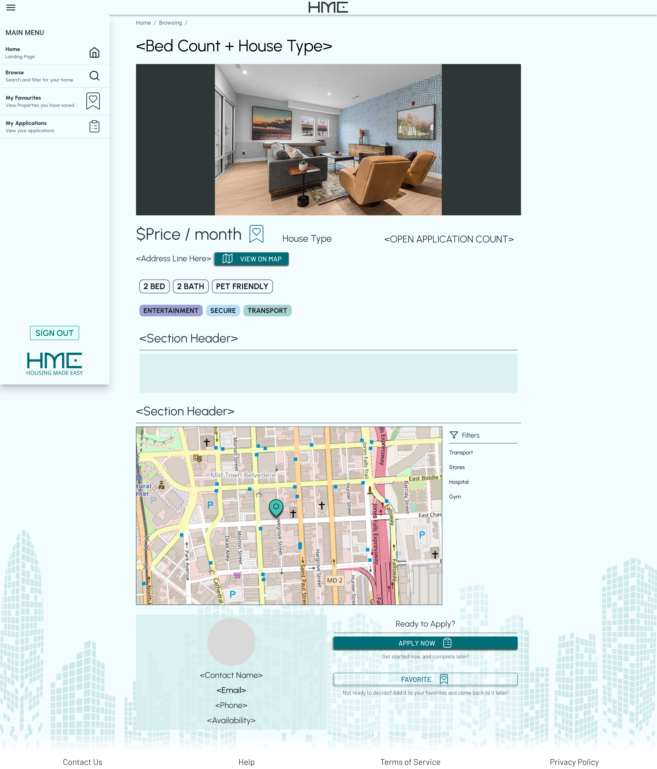

Slide 12


Slide 13
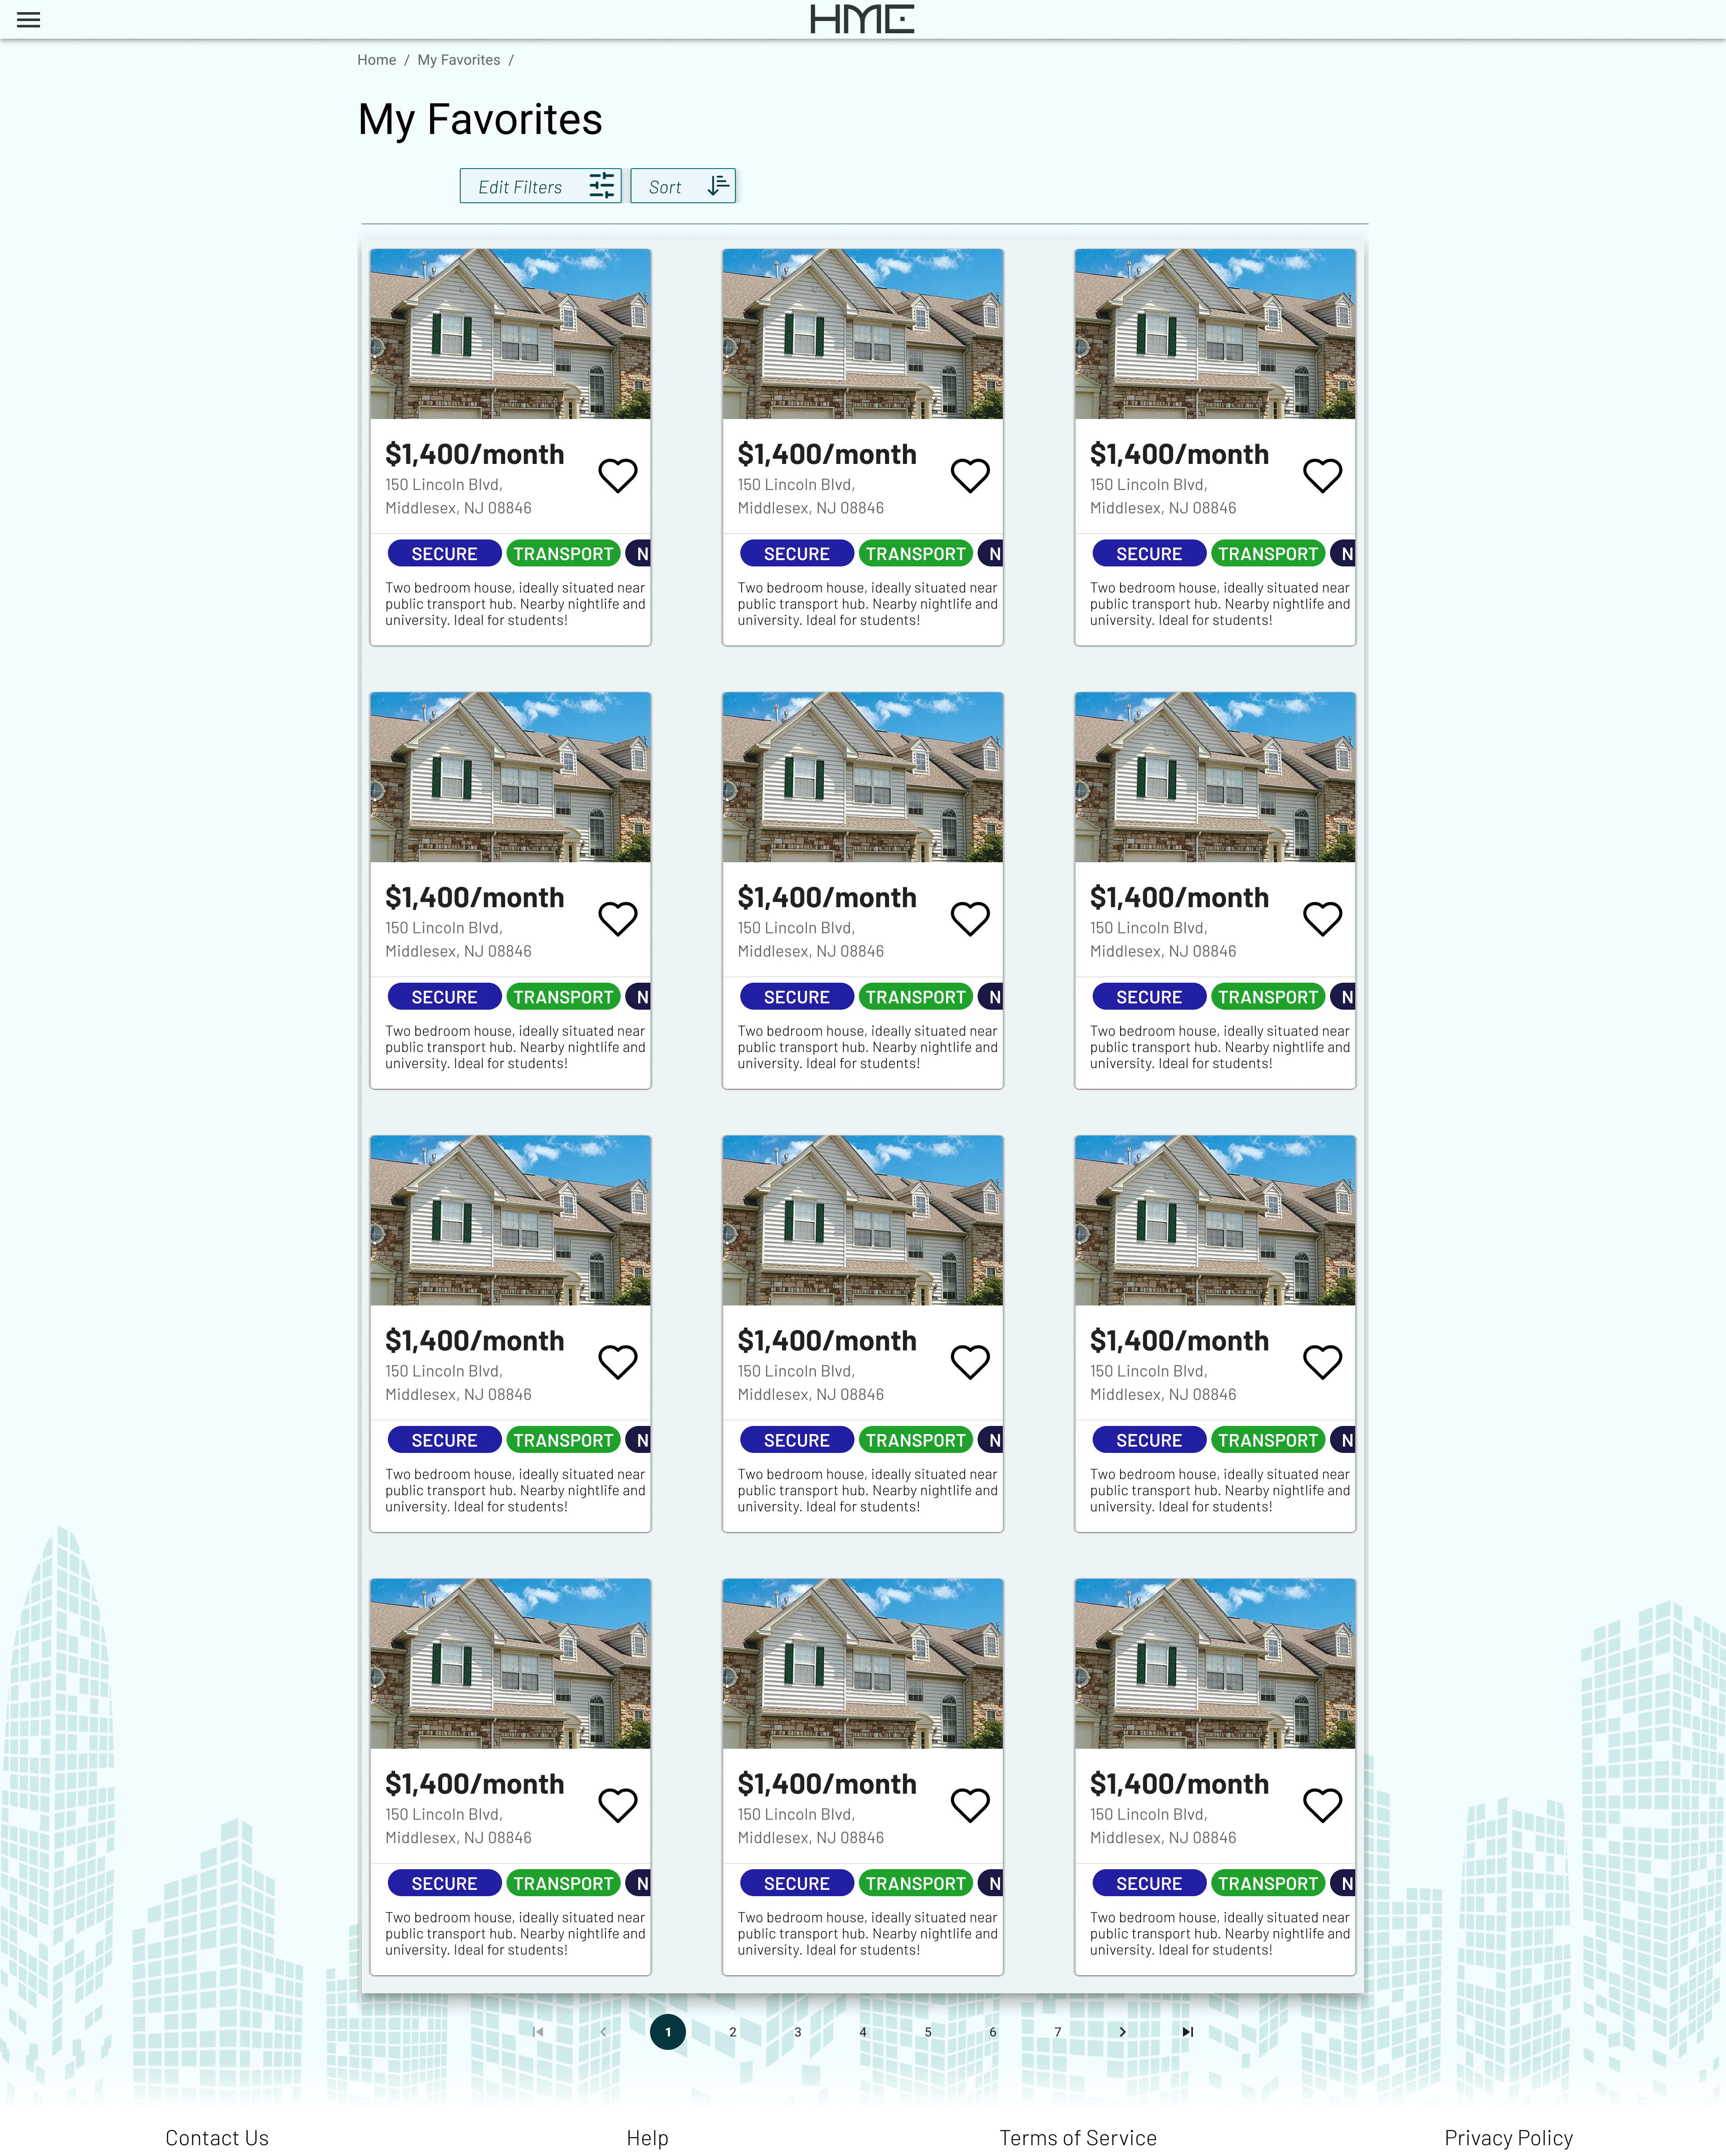

Slide 15
Applying

Slide 18
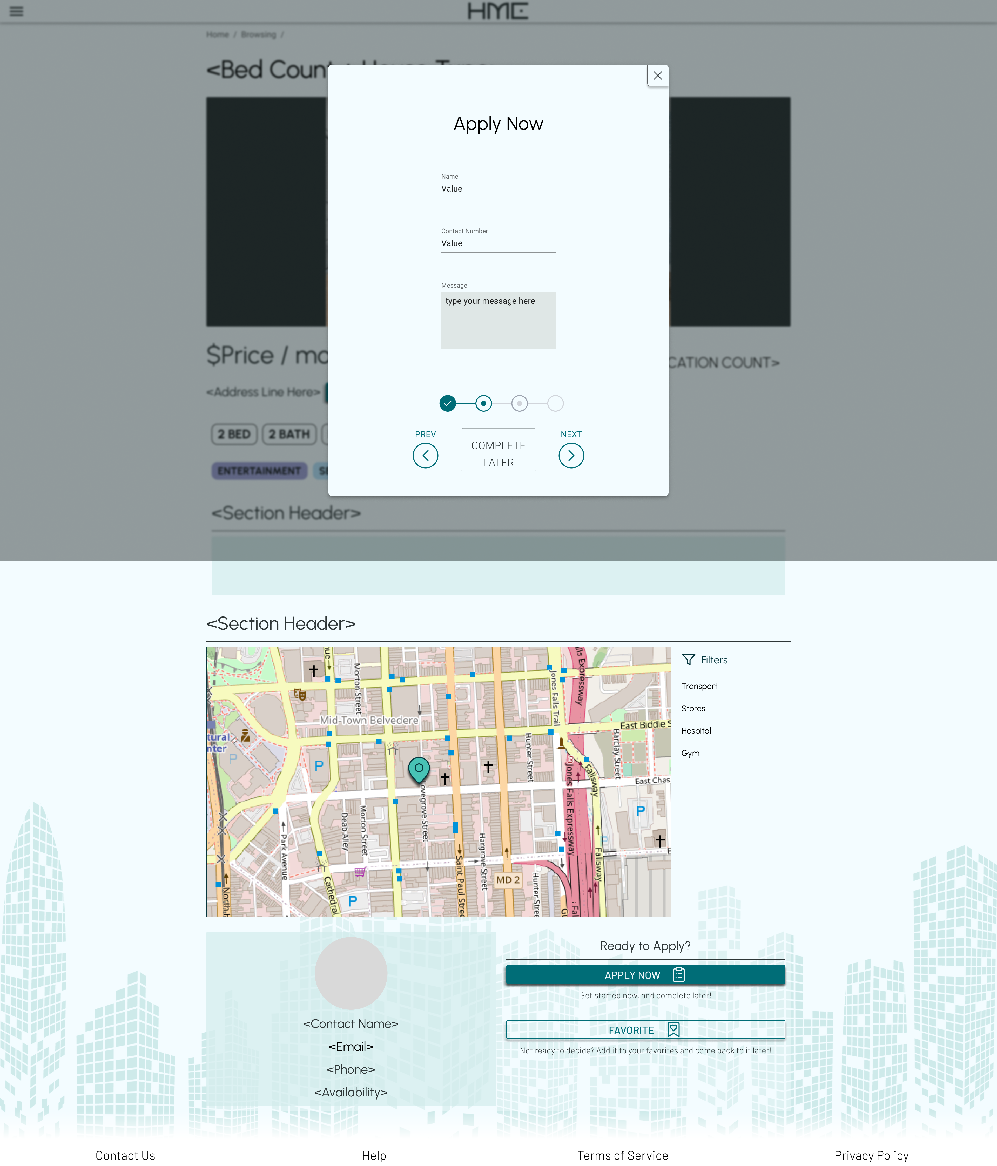

Slide 20


Slide 21
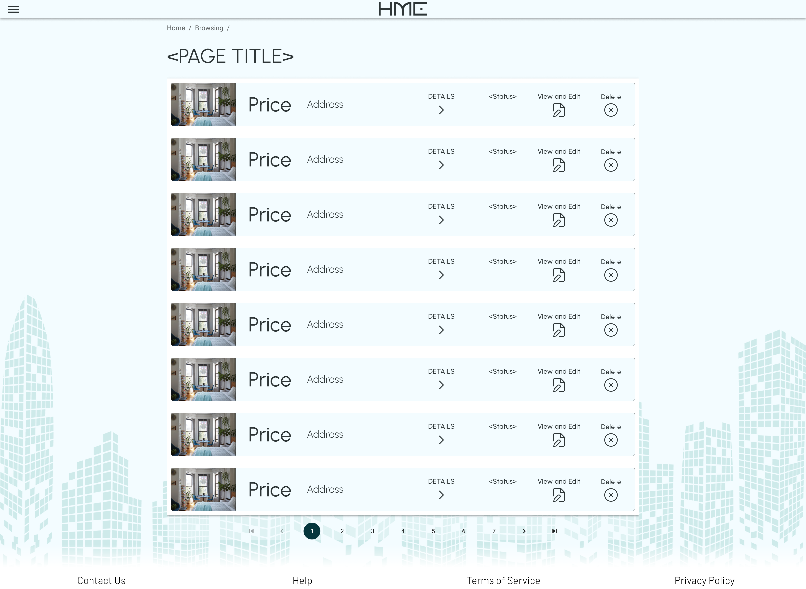

Slide 22
